Slide 1

Maidin Mhaith
Date: enter date here
NEWS & REMINDERS:
TO DO:
Where are the lakes always empty, the mountains always flat and the rivers always still?
Would you rather be busy or bored?
My mistakes help me learn and grow.
RIDDLE OF THE DAY:
WOULD YOU RATHER:
POSITIVE THOUGHT:

Slide 2
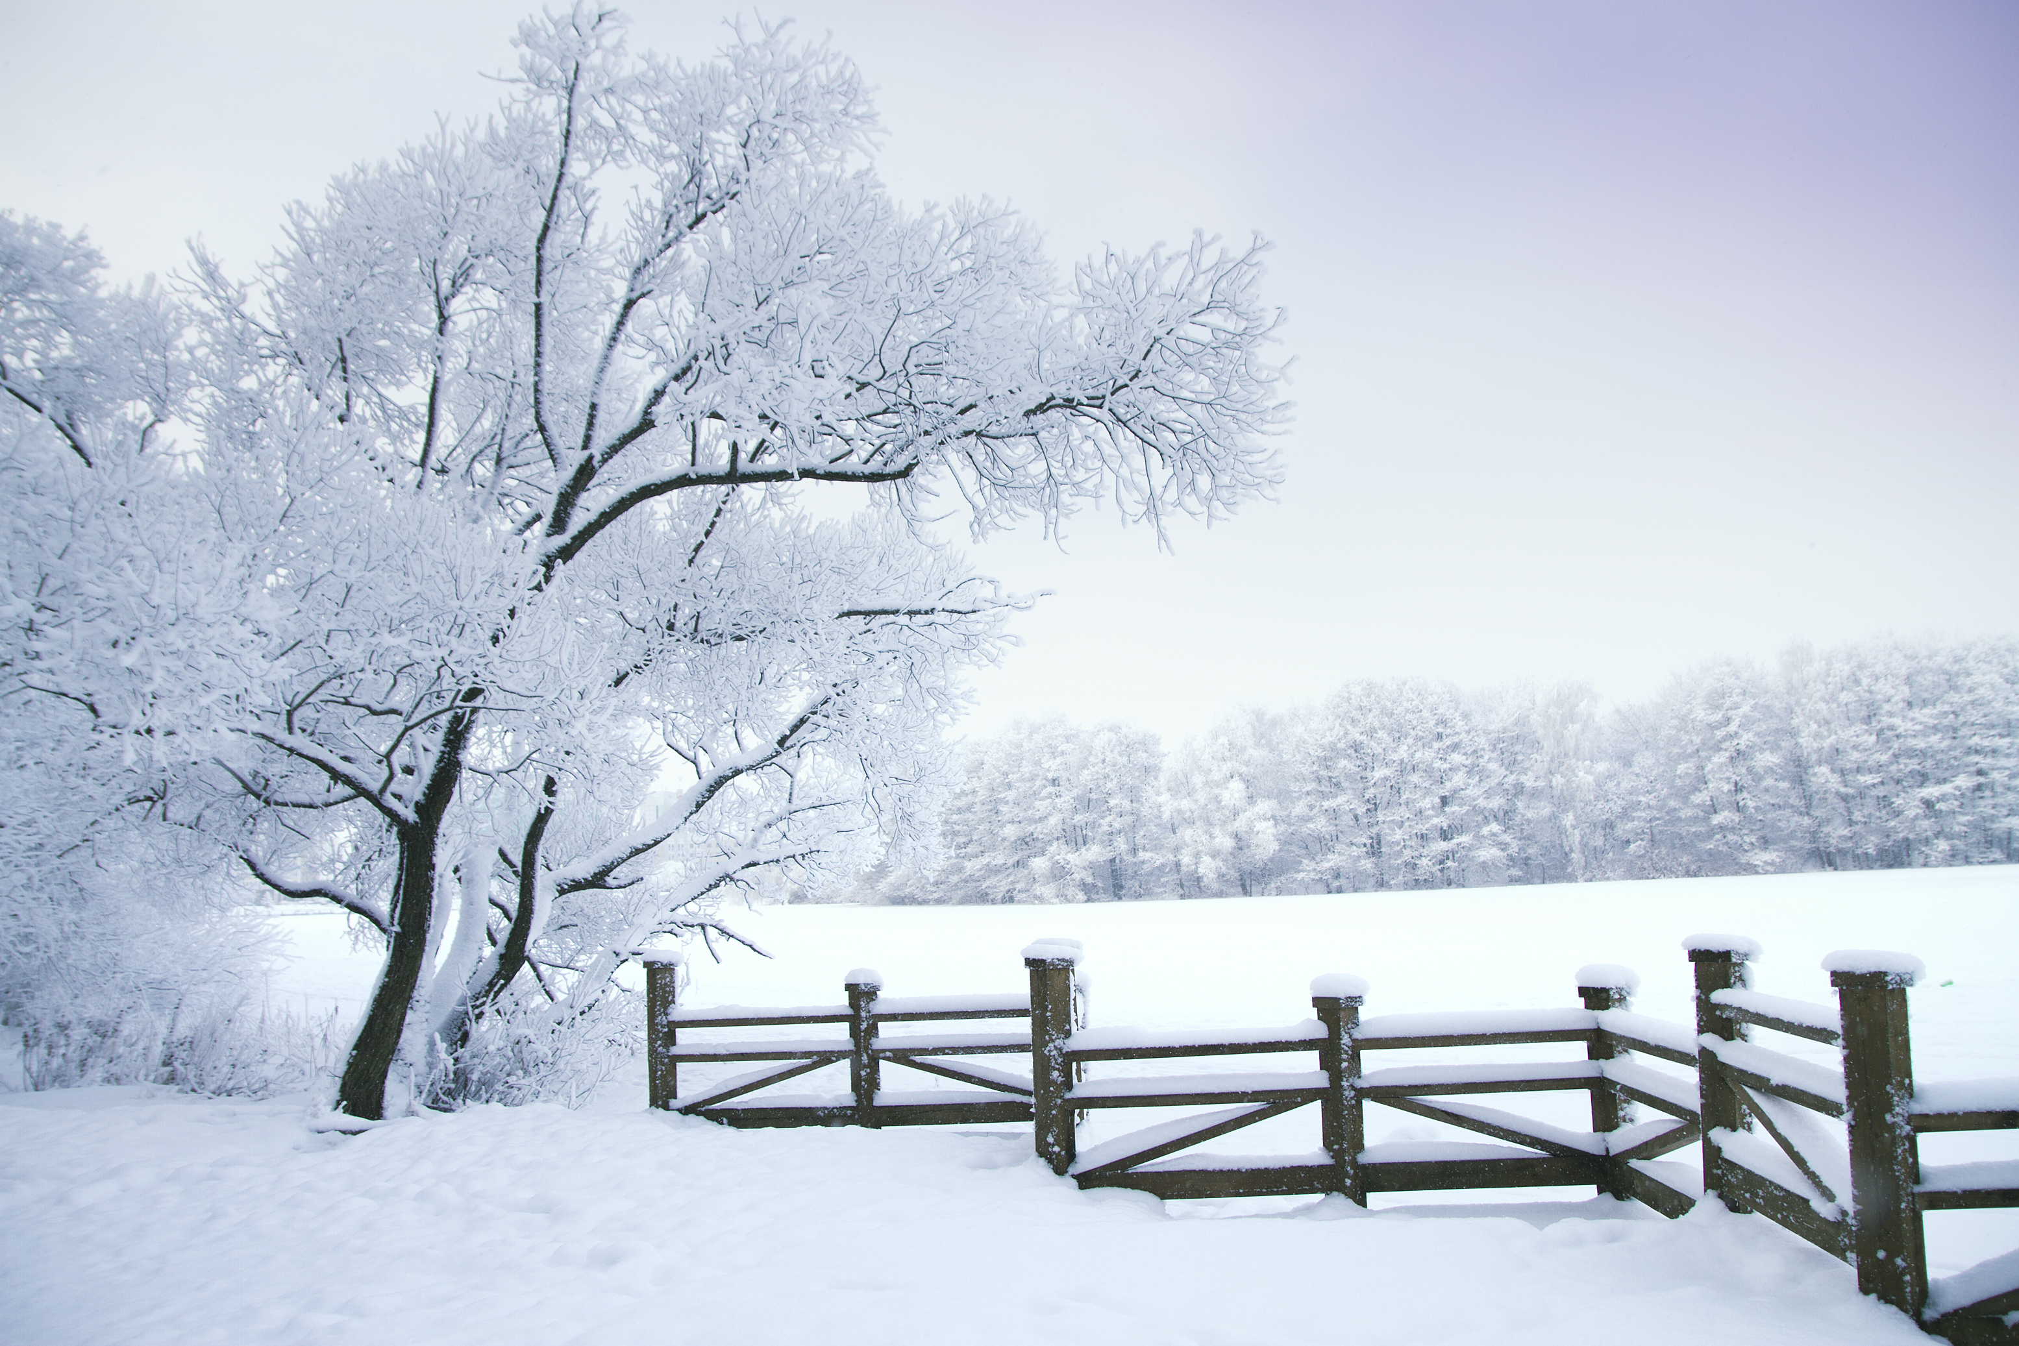
Maidin Mhaith
Date: enter date here
NEWS & REMINDERS:
TO DO:
What can fill a room but doesn’t take up space?
Would you rather live at the top of a skyscraper or the top of a mountain?
I can work through my problems.
RIDDLE OF THE DAY:
WOULD YOU RATHER:
POSITIVE THOUGHT:

Slide 3
Maidin Mhaith
Date: enter date here
NEWS & REMINDERS:
TO DO:
It belongs to you, but your friends use it more. What is it?
Would you rather look into the past or into the future?
I get better every single day.
RIDDLE OF THE DAY:
WOULD YOU RATHER:
POSITIVE THOUGHT:

Slide 4
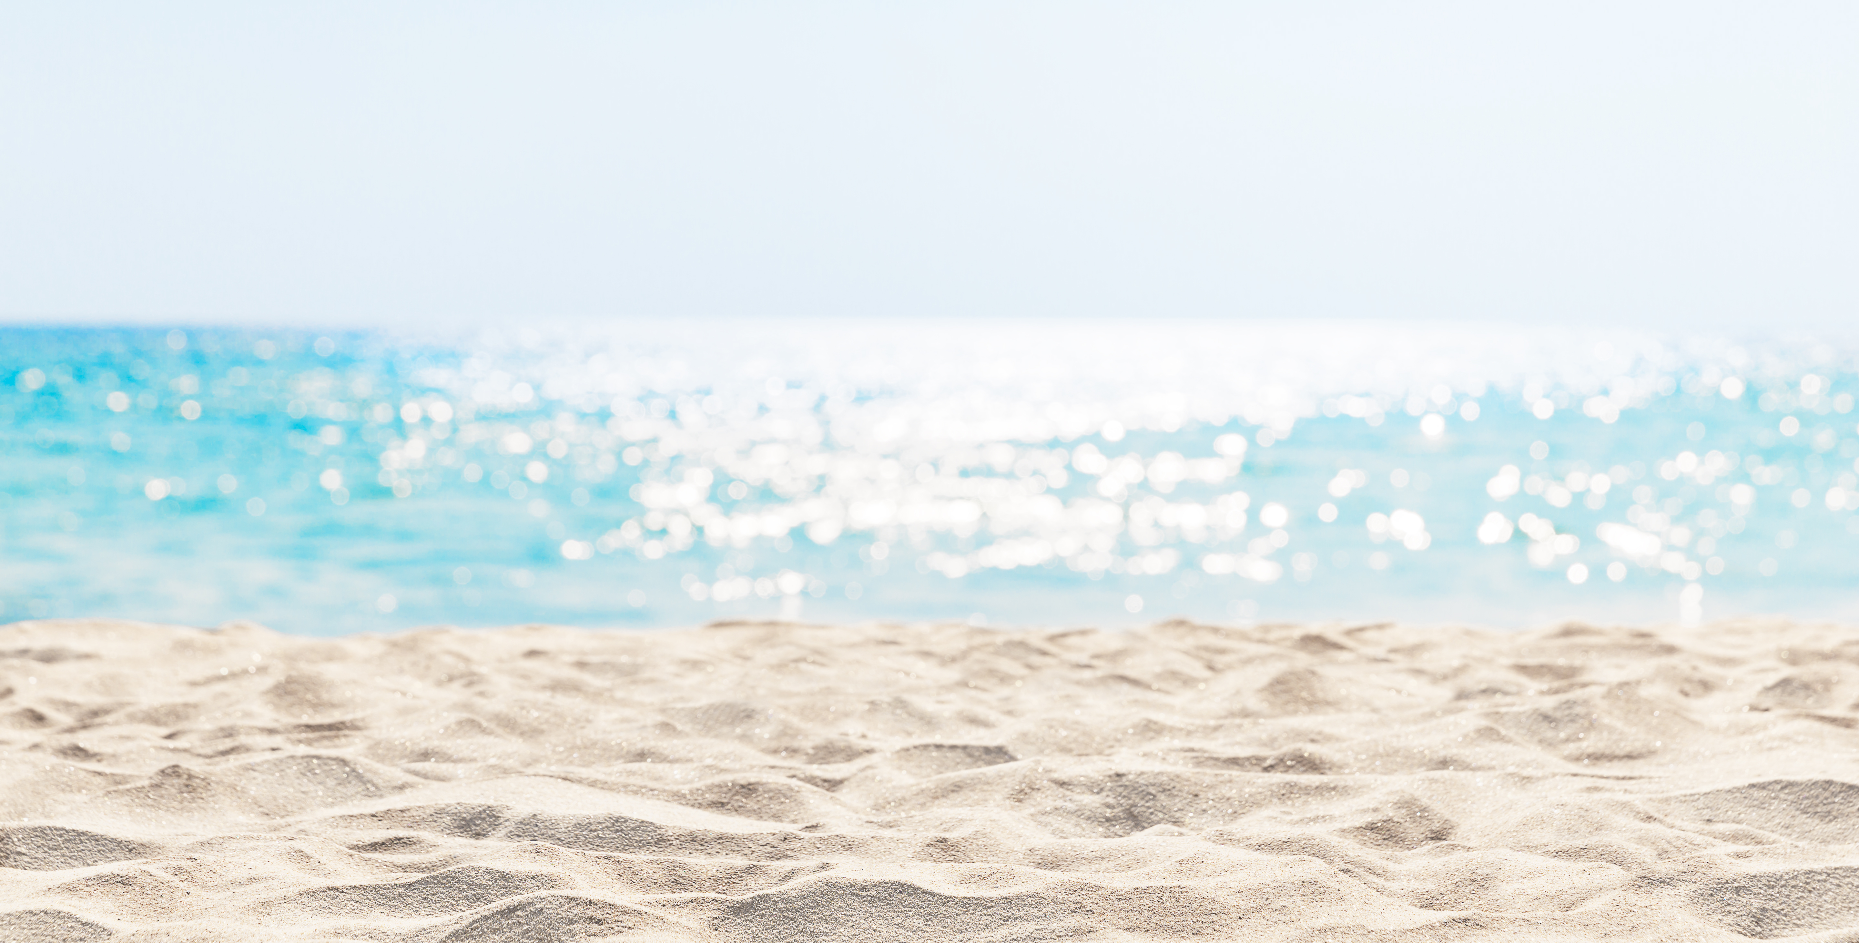
Maidin Mhaith
Date: enter date here
NEWS & REMINDERS:
TO DO:
What has many keys but can’t open a single lock?
Would you rather be locked in school or in a library?
Today is going to be a great day.
RIDDLE OF THE DAY:
WOULD YOU RATHER:
POSITIVE THOUGHT:

Slide 5
Riddle: It belongs to you, but your friends use it more. What is it?
Answer: Your name
Riddle: I am so simple that I can only point, yet I guide people all over the world.
Answer: Compass
Riddle: What can you catch but not throw?
Answer: A cold
Riddle: What begins with T ends with T and has T in it?
Answer: A teapot
Riddle: What has thirteen hearts, but no other organs?
Answer: A deck of cards
Riddle: What is easier to get into than out of?
Answer: Trouble
Riddle: Remove my skin and I won’t cry, but you might!
Answer: An onion
Riddle: What can fill a room but doesn’t take up space?
Answer: Light
Riddle: Where are the lakes always empty, the mountains always flat and the rivers always still?
Answer: A map
Riddle: A man looks at a painting and says, “Brothers and sisters I have none, but that man’s father is my father’s son.” Who is in the painting?
Answer: His son
Riddle: What has many keys but can’t open a single lock?
Answer: A piano
Riddle: What is always in front of you but can’t be seen?
Answer: The future

Slide 6
Would you rather have more time or more money?
Would you rather be able to talk with the animals or speak all foreign languages?
Would you rather read an awesome book or watch a good movie?
Would you rather explore space or the ocean?
Would you rather have x-ray vision or magnified hearing?
Would you rather be too hot or too cold?
Would you rather live at the top of a skyscraper or the top of a mountain?
Would you rather look into the past or into the future?
Would you rather be locked in school or in a library?
Would you rather have music or books if stuck on an island for a month?
Would you rather be busy or bored?

Slide 7
There is no one better to be than myself.
I am enough.
I get better every single day.
I am an amazing person.
I can work through my problems.
Today I am a leader.
I forgive myself for my mistakes.
My challenges help me grow.
I am perfect just the way I am.
My mistakes help me learn and grow.
Today is going to be a great day.
I have courage and confidence.

