Slide 1
The Adventure Playground
An Interactive Story
BEGIN

Slide 2
The playground
“What a great place!” you exclaim.
There is so much to do. You can see some slides and swings and there is a gate that leads to a garden area. You can hear a noise behind some trees.
Go to the slides and swings
Go to the garden
Follow the sound
Leave the playground

Slide 3
Explore the garden
There are so many plants in the garden, and it smells wonderful
“Would you like to plant some seeds or harvest some fruit or vegetables?” asks the gardener.
Plant some seeds
Harvest some fruit or vegetables
Go back
Notes:
NOTE: To change images on this slide, select a picture and delete it. Then click the Insert Picture icon in the placeholder to insert your own image.

Slide 4
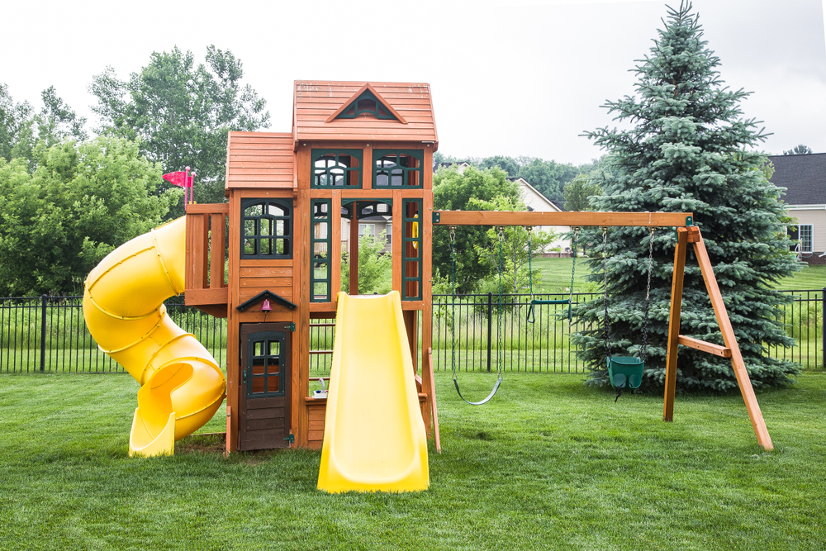
Swings and slides!
This looks so much fun.
Which will you go on first?
Try the swings
Try the slide

Slide 5
Plant seeds
You are given some seeds by the gardener.
“Make a small hole just like this,” says the gardener. “Then pop in a seed.”
You follow the instructions and have planted some seeds. They will take some time to grow. You will need come back in a few weeks.
Go back

Slide 6
Harvest vegetables
You can see some Strawberries peeping from under some leaves. They look plump and juicy! “Can I?” you ask. “Of course,” says the gardener.
They taste as good as they look!
Go back

Slide 7
Following the sound
A band are playing some tunes. Lots of people are sitting around listening.
Stay a while
Go back

Slide 8
Trying the swings
The swing is really good. You swing it higher and higher.
“I wonder if I could make it go right over the top?” you think. You are starting to feel a bit sick. Time to stop. Try the slide.
Go back

Slide 9
Trying the slide
You feel your legs begin to tremble as you climb to the top of the slide. “I can do this… I can do this!” you say. It looks a long way down. With a deep breath, you let yourself go…. WHEEEEEEE!!!!!
Try the swings Go back

Slide 10
Stay a while
You relax in the sun listening to the gentle music.
You slowly drift off to sleep.
A dog licks you on your nose and you quickly wake up. “Urghhhhh. Wet nose!”
Go back

Slide 11
Bye!
Did you do everything you wanted?
Click ESCAPE to leave the story now.
Or you can continue the adventure.
Go back to the playground

